Slide 1
AI & Machine Learning
CA2 PART B: Unsupervised Learning
By: Yek Yi Wei (p2107631)
Diploma in Applied AI & Analytics

Slide 2
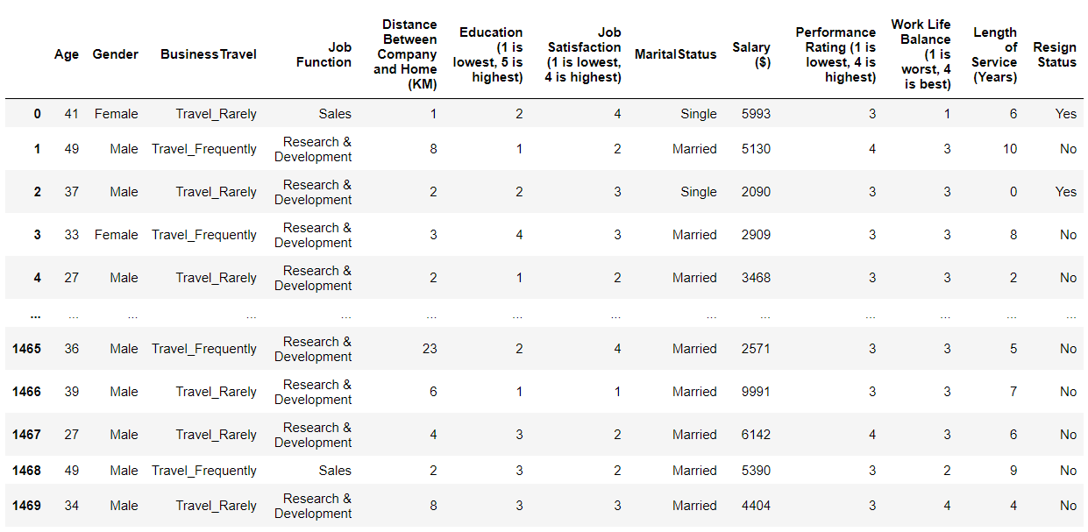

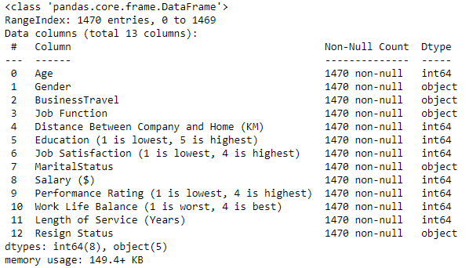
Default dataset

Slide 3
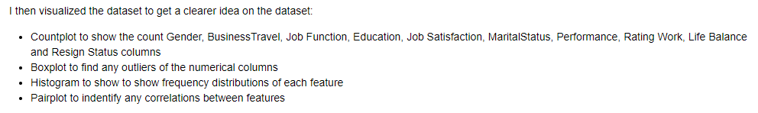
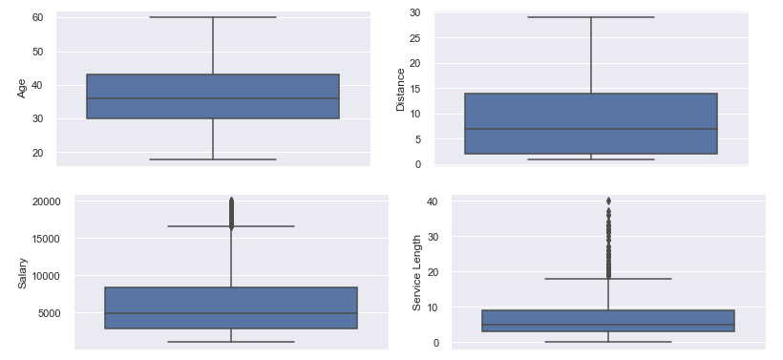
EDA: Exploratory Data Analysis
Check Outlier

Slide 4
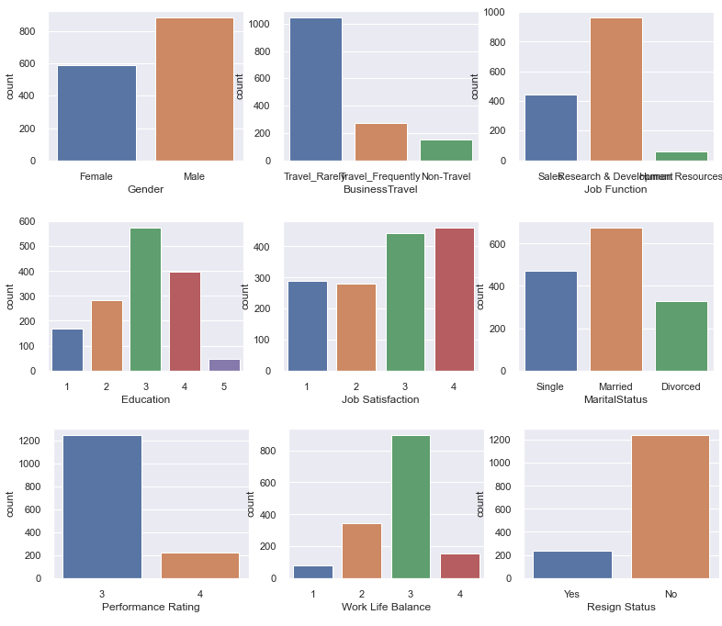
EDA: Exploratory Data Analysis

Slide 5
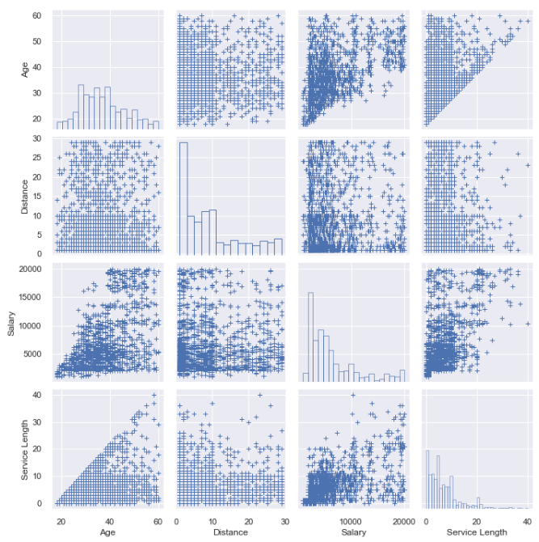
EDA: Exploratory Data Analysis

Slide 6
EDA: Exploratory Data Analysis
wide variety of ages (20 to 60)
Most of the Salary falls between 2500 to 5000

Slide 7
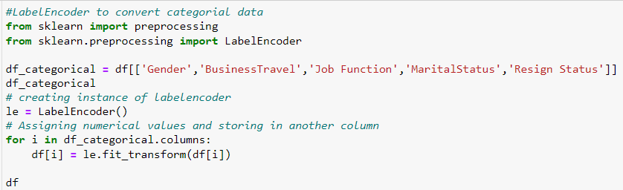
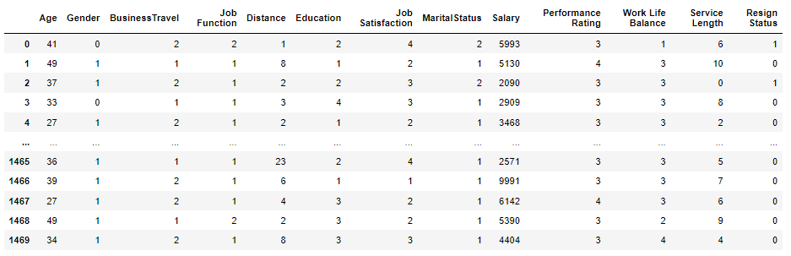
Data Processing

Slide 8
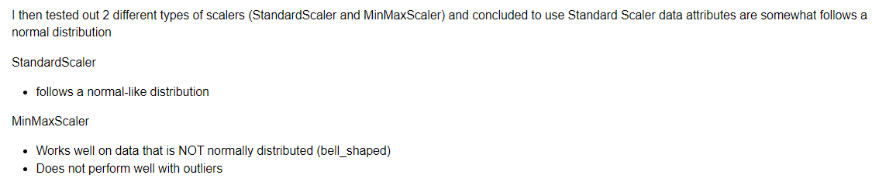
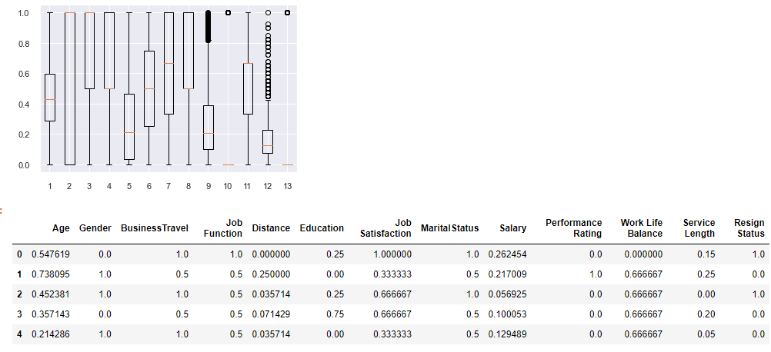
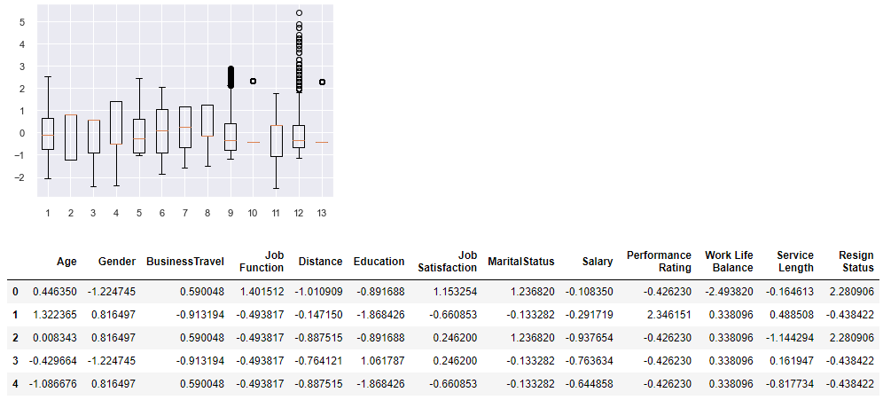
Data Processing
MinMaxScaler
StandardScaler

Slide 9
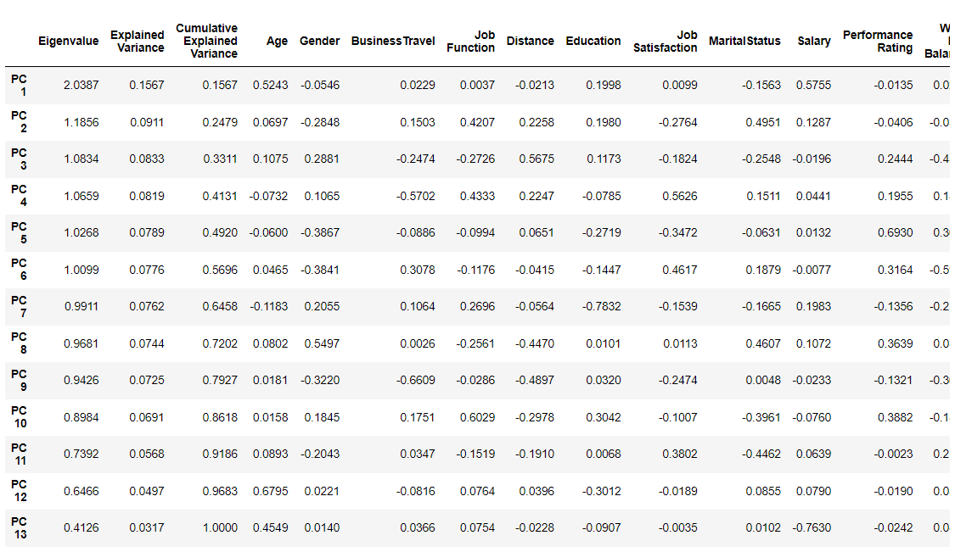
Dimension Reduction

Slide 10
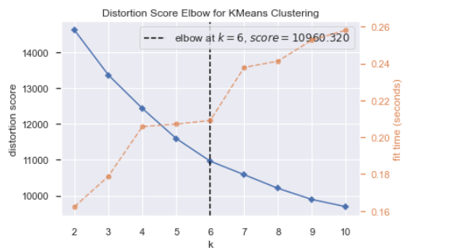
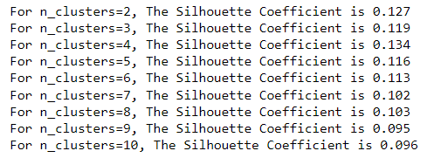
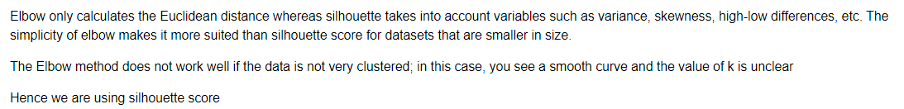
Process of K-Means Clustering Finding the Optimal Number of Clusters
Silhouette Coefficient is too low, k=3 is chosen since it has the highest value.

Slide 11
Agglomerative Clustering ~other clustering Algorithm
using silhouette score, choose k=3

Slide 12
Model Improvement Clustering on the basis of 4 features (Age, Distance, Salary, Service Length )

Slide 13

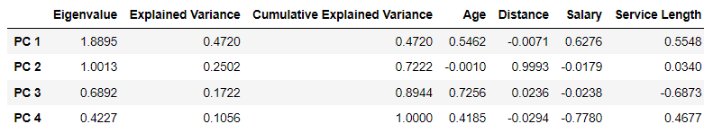
Dimension Reduction

Slide 14
Model Improvement Clustering on the basis of 4 features (Age, Distance, Salary, Service Length )

Slide 15
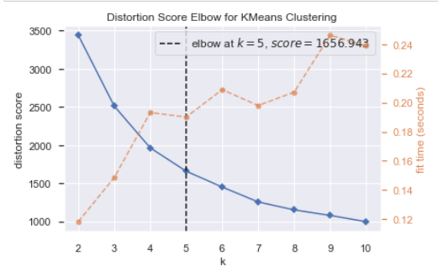
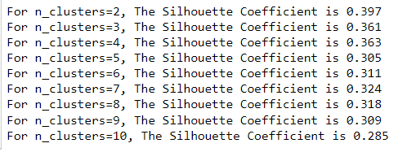
Process of K-Means Clustering Finding the Optimal Number of Clusters
Silhouette Coefficient k=2 not chosen because age and length of service related, k=4 is chosen since it has the highest value

Slide 16
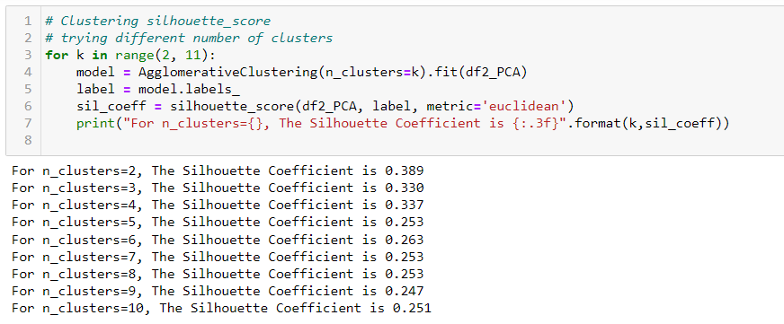
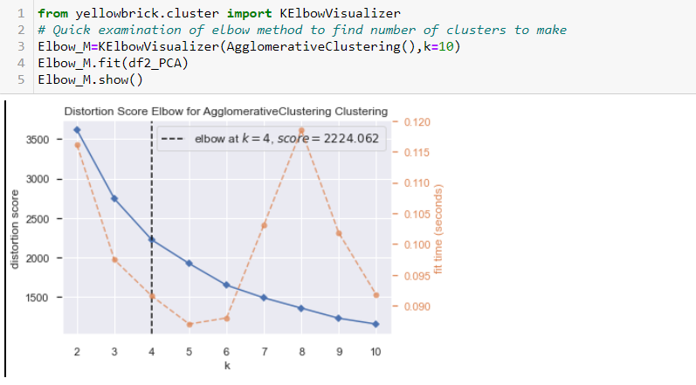
Model Improvement Clustering on the basis of 4 features (Age, Distance, Salary, Service Length )

Slide 17
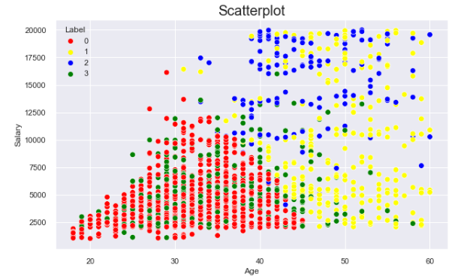
KMeans Clustering
Blue cluster has more senior employee with higher salary
Yellow Cluster has more senior employees and their salary are widely spread
Red Cluster has lower salary with age less than 45
Green Cluster is overlap with Red Cluster

Slide 18
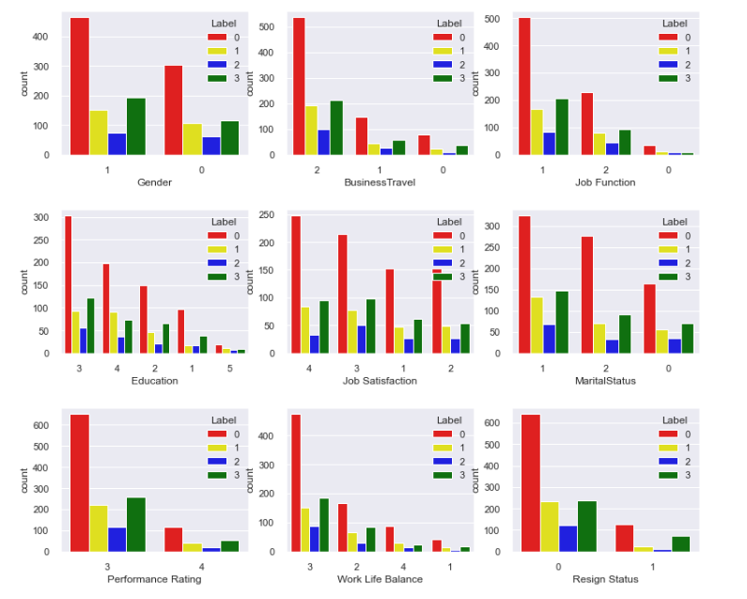
Red cluster rarely travel and working in R&D
Red cluster are more likely to resign

Slide 19
Red cluster consists of younger employees (lower age and service length) and they have lower salary
Blue cluster has highest salary and longer service

Slide 20
Conclusion
Red cluster consists of younger employees (lower age and service length) and they have lower salary
Red cluster rarely travel and working in R&D
This group of employees are more likely to resign
Management should provide higher salary, prepare more condusive environment for them especially those who work in R&D department.

